Slide 1
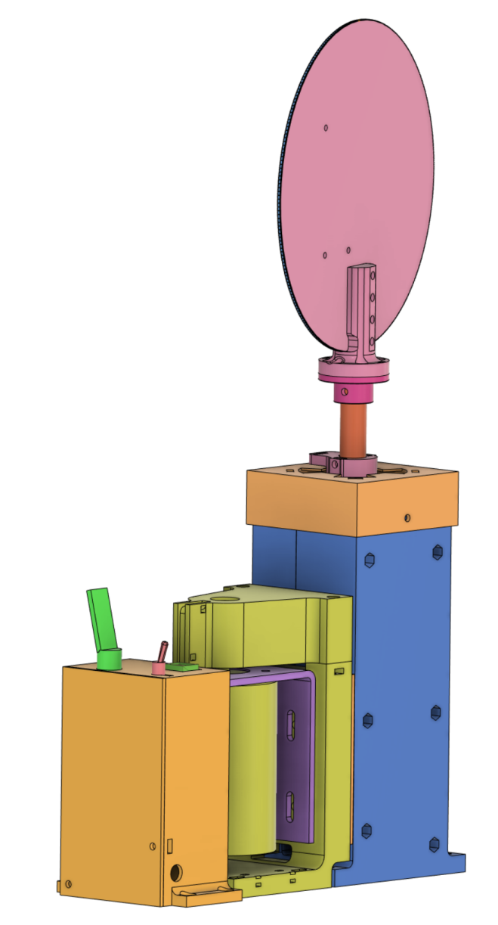
LED PCB
Timing
mechanism
Motor drive
electronics
Motor drive
Shaft enclosure

Slide 2
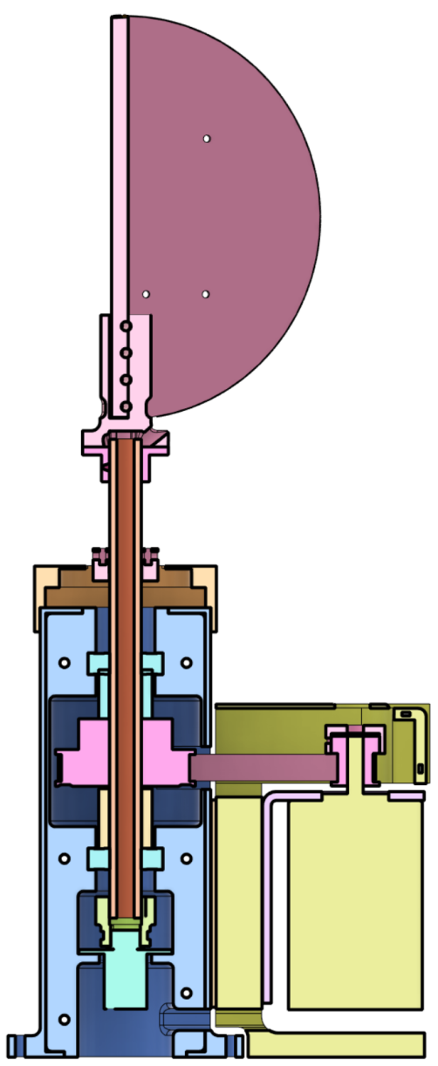
LED PCB
PCB mount
Shaft collar
16mm
hollow shaft
Top bearing
Top spacer
Belt
Large Pulley
Small
pulley
Bottom
spacer
Bottom
bearing
Motor
Slip ring coupler
Slip ring

Slide 3
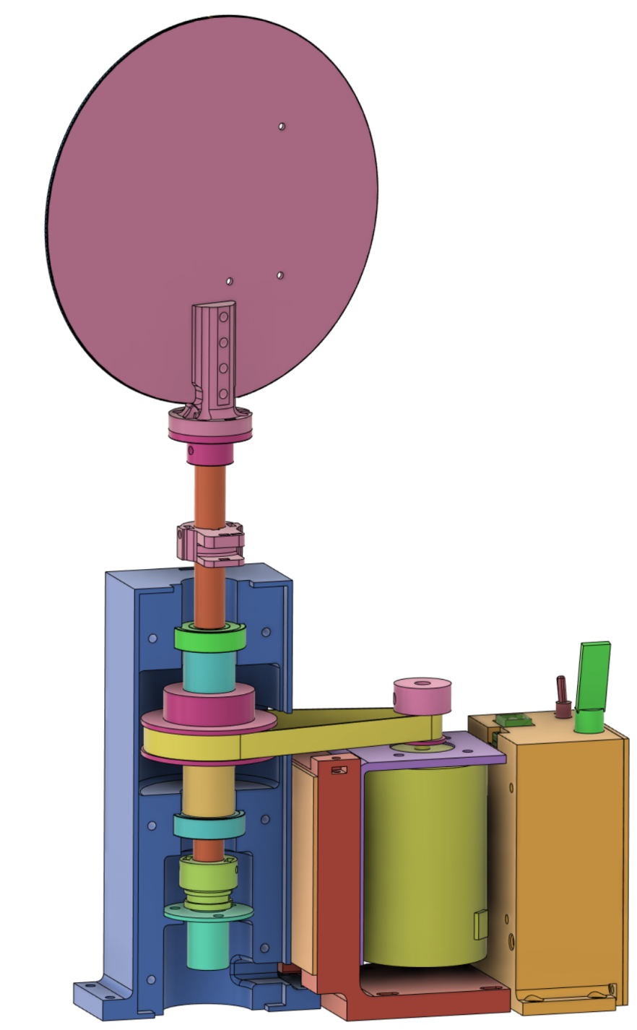
LED PCB
PCB mount
Shaft collar
16mm
hollow shaft
Photo-interrupter
mount
Motor speed
magnet
Top bearing
Top spacer
Belt
Small
pulley
Large Pulley
Bottom
spacer
Motor
Bottom
bearing
Slip ring coupler
Slip ring

Slide 4
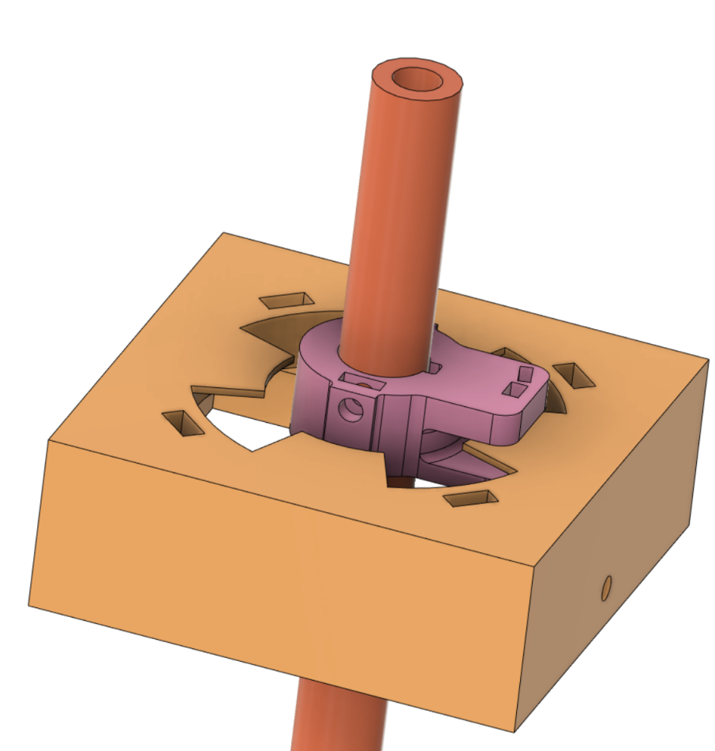
Hollow shaft
Sensor mount
Slots

Slide 5
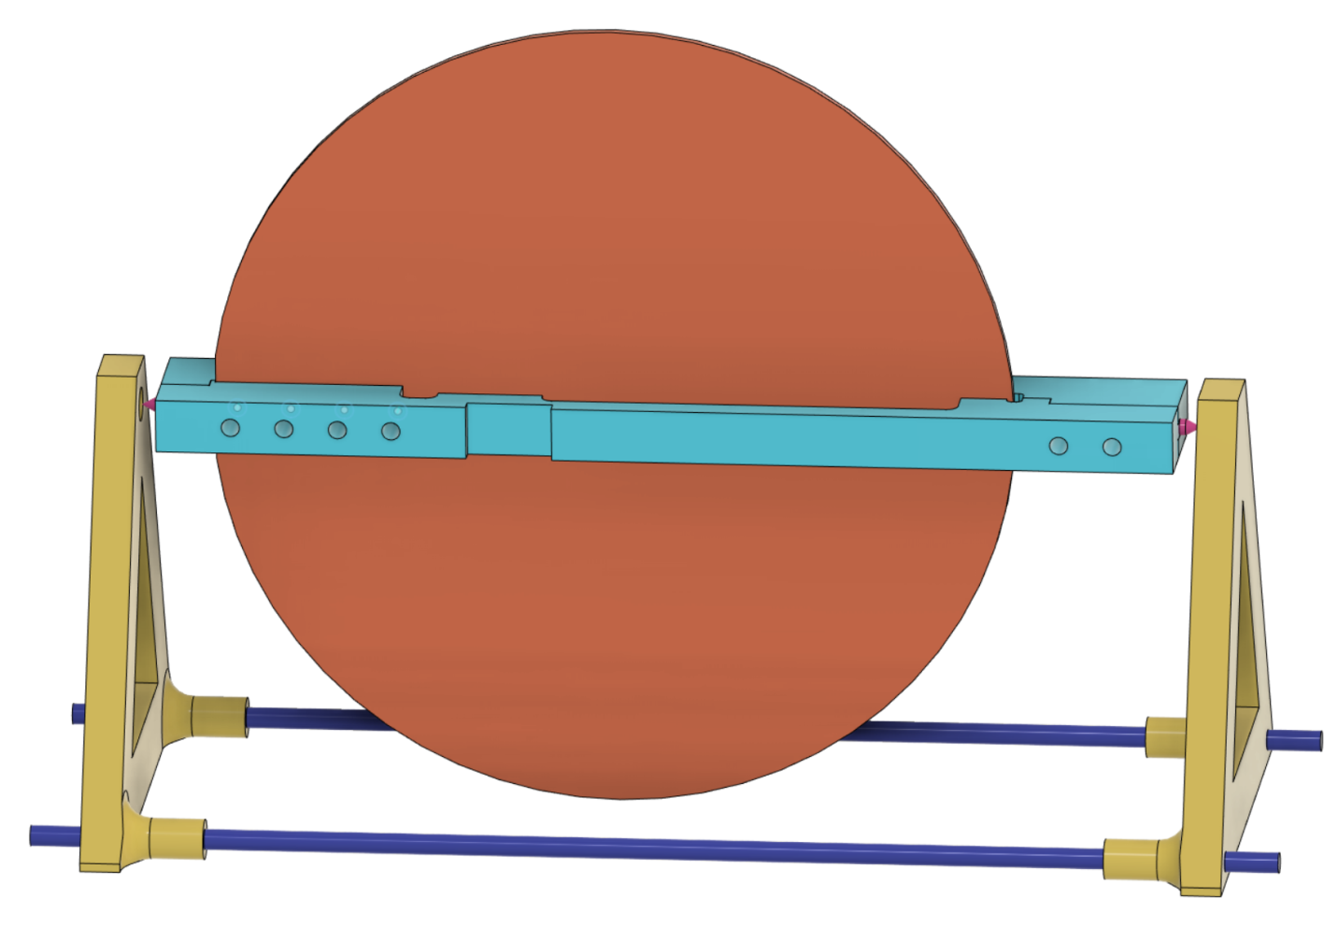
PCB
Small (pointy)
Screw (x2)
PCB holder
Magnet
Balance stand
(x2)
Threaded rod
(nuts not shown)

Slide 6
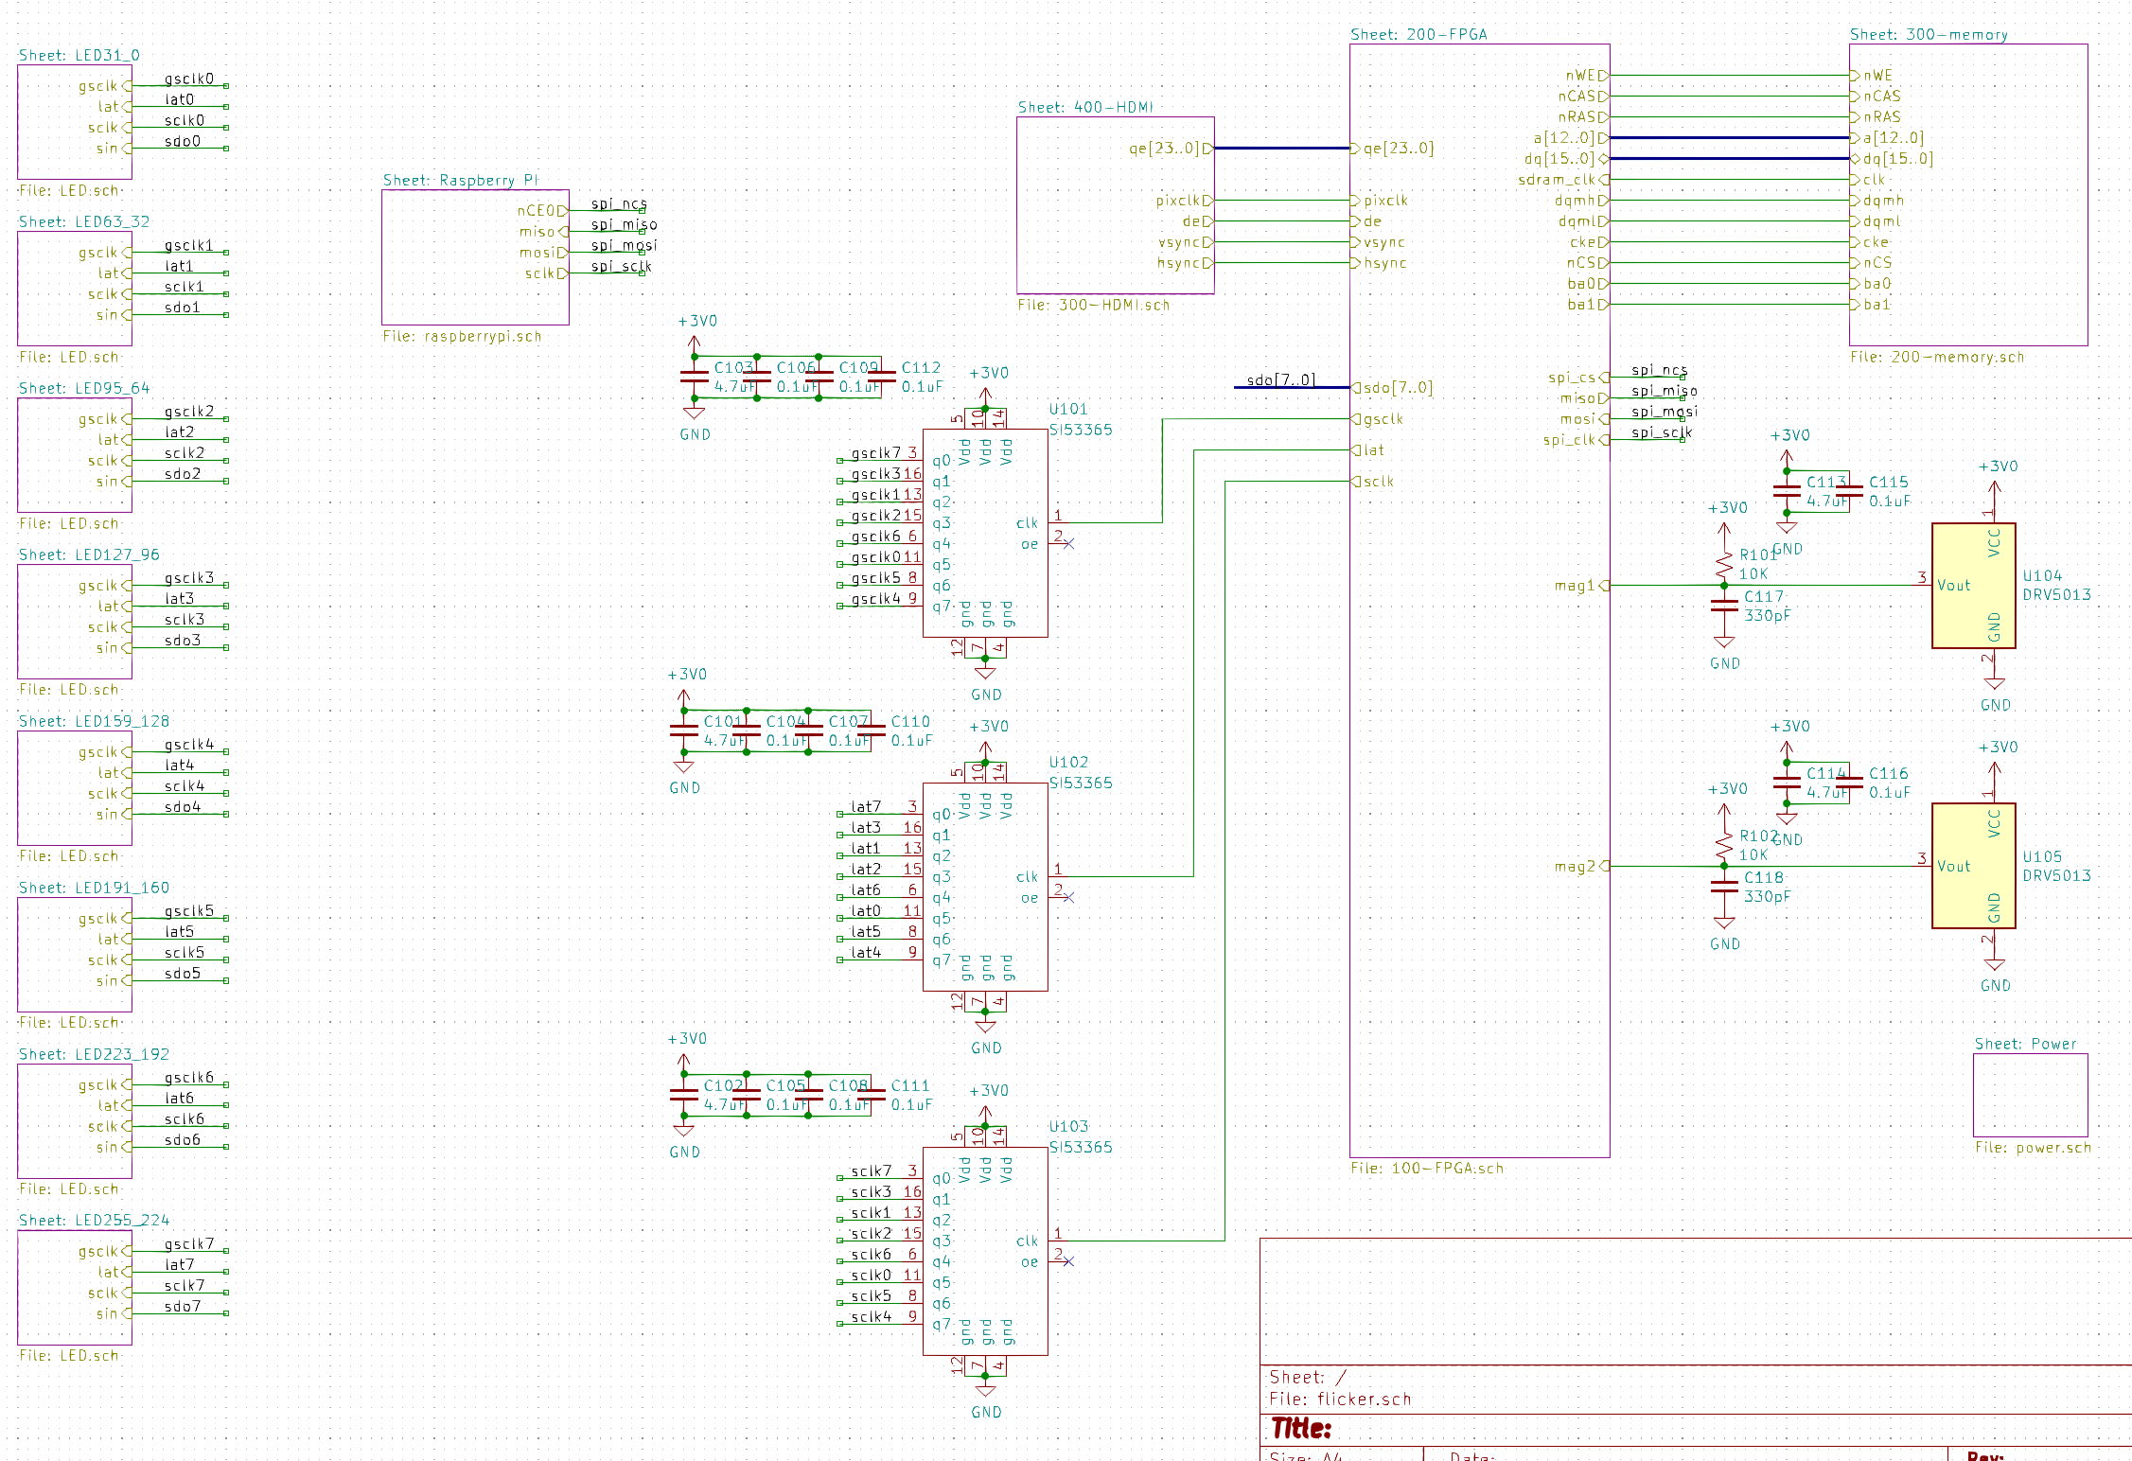

Slide 7
Raspberry PI
HDMI
FPGA
Photo-interrupter
LED Driver
LED Driver
LED Driver
SDRAM

Slide 8
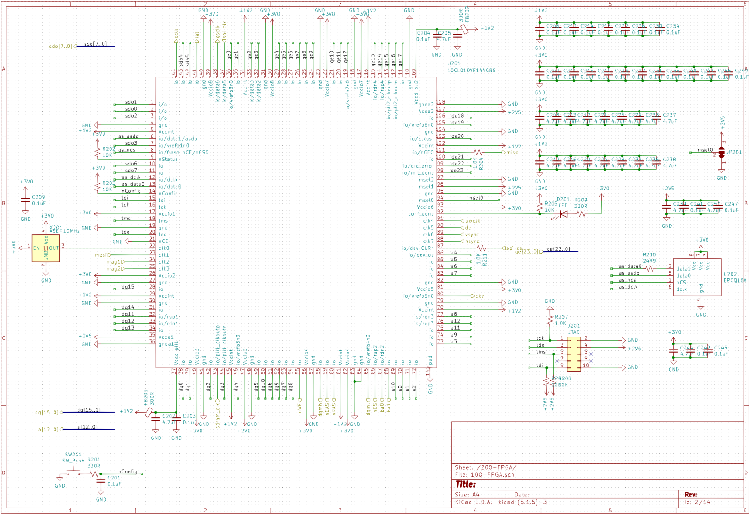

Slide 9
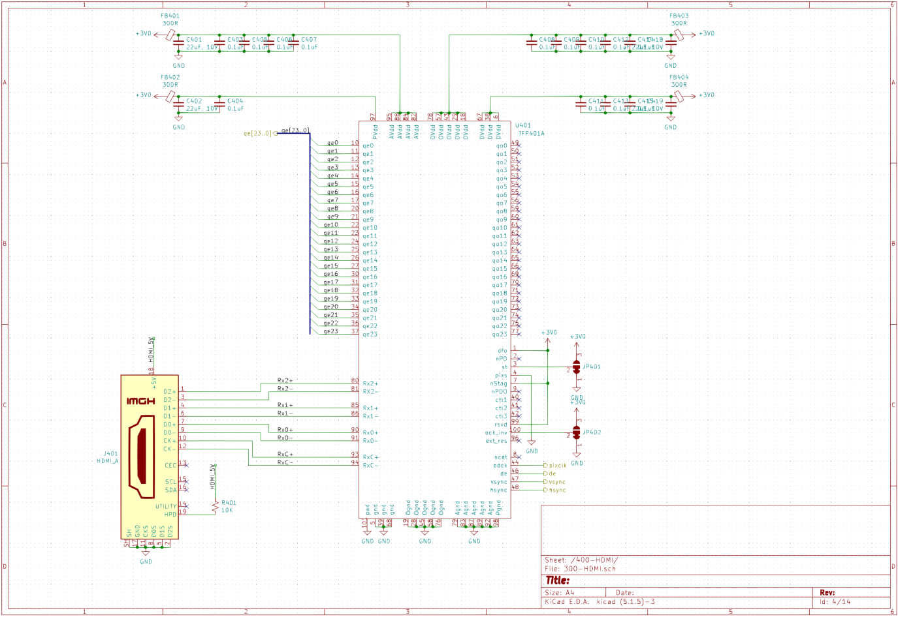

Slide 10
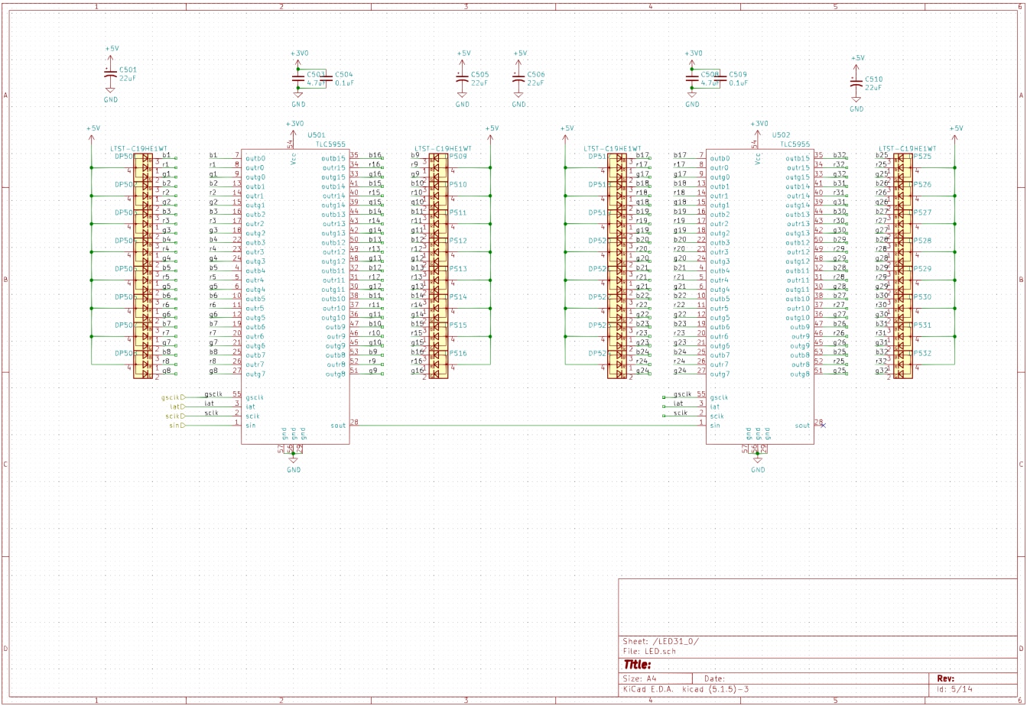

Slide 11
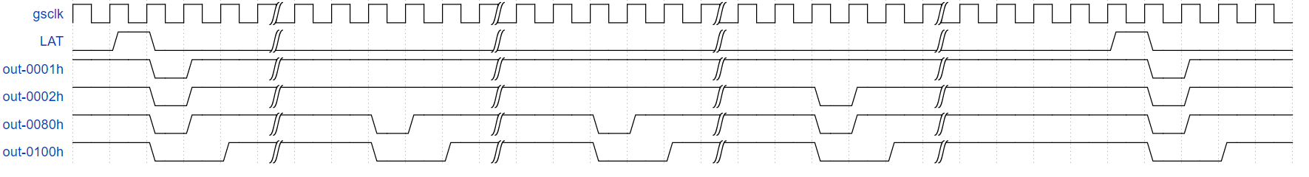
Bin 1
Bin 2
Bin 65
32766
32767
32769
32770
1
2
3
4
511
512
513
514
515
516
32768
32771
https://wavedrom.com/editor.html
Notes:
{signal: [
{name: 'gsclk', wave: 'p....|.....|.....|.....|.........'},
{name: 'LAT', wave: '010..|.....|.....|.....|....10...'},
{name: 'out-0001h', wave: '1.01.|.....|.....|.....|.....01..'},
{name: 'out-0002h', wave: '1.01.|.....|.....|..01.|.....01..'},
{name: 'out-0080h', wave: '1.01.|..01.|..01.|..01.|.....01..'},
{name: 'out-0100h', wave: '1.0.1|..0.1|..0.1|..0.1|.....0.1.'},
]}

Slide 12
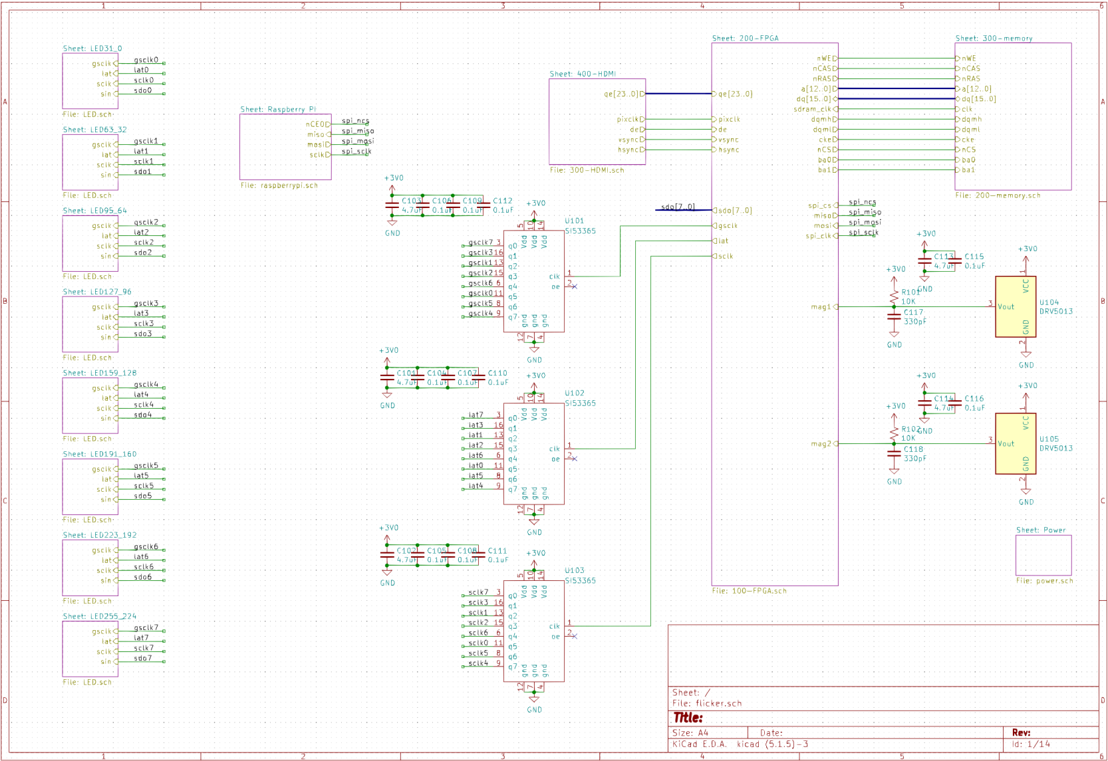

Slide 13
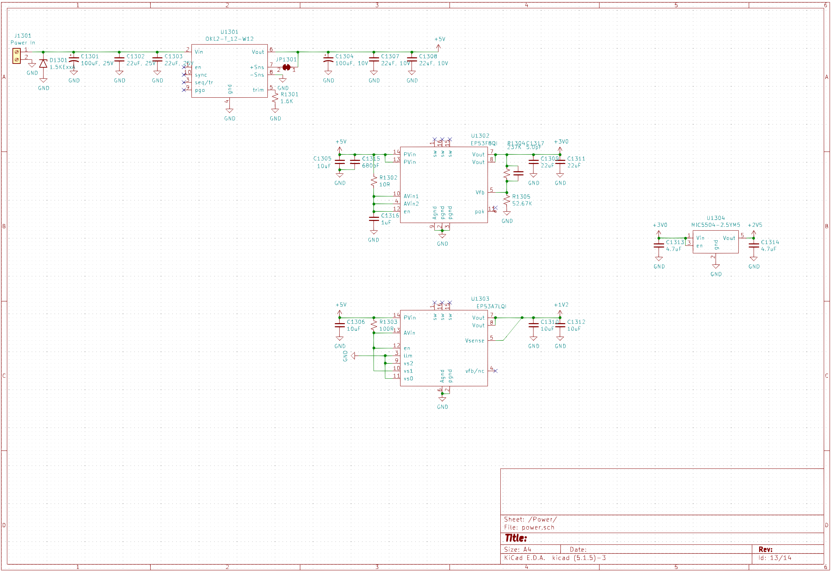

Slide 14
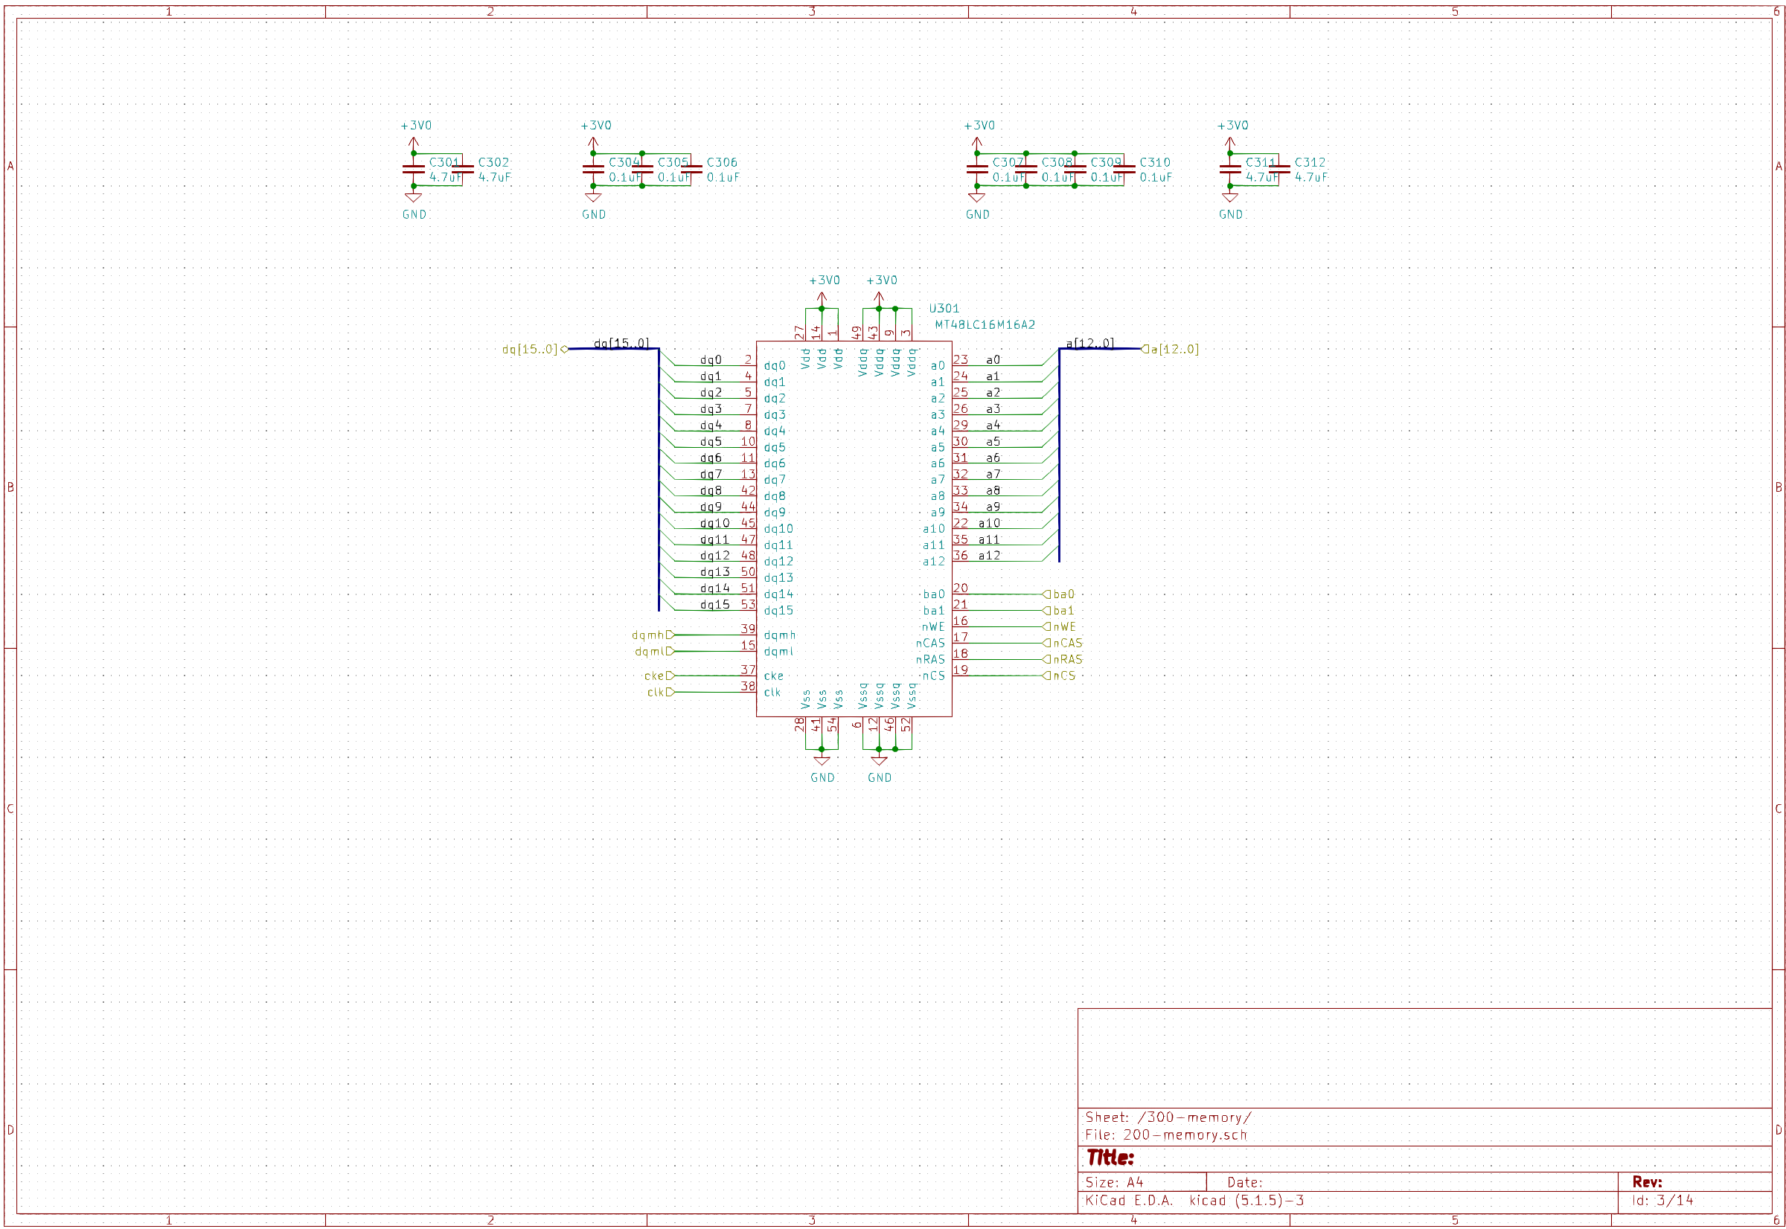

Slide 15
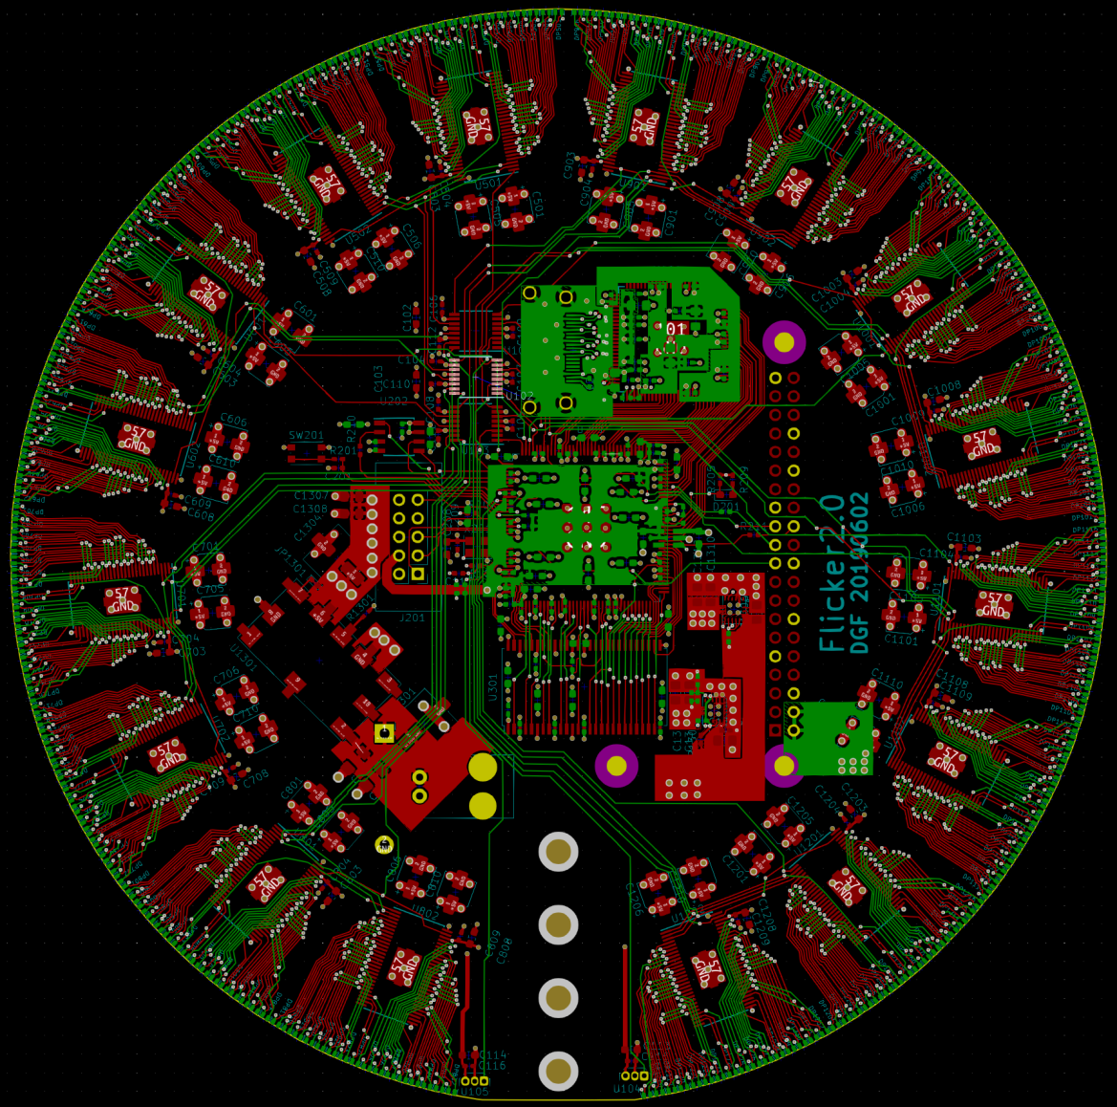

Slide 16
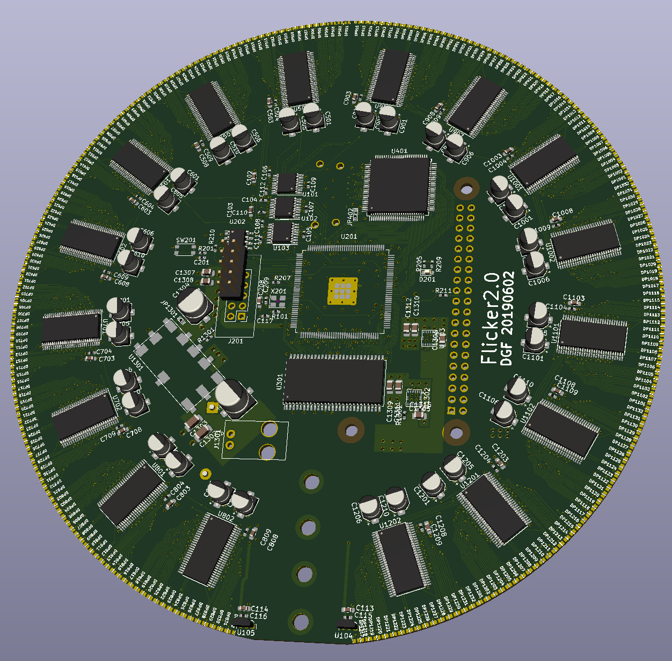
LED driver
x16
Clock driver
x3
DVI decoder
LED x256
Raspberry PI
header
FPGA
JTAG
DC/DC
+3.3V/1.2V
5V DC/DC
Power Connector
SDRAM
Hall effect sensors (x2)
PCB mounting holes x4

Slide 17
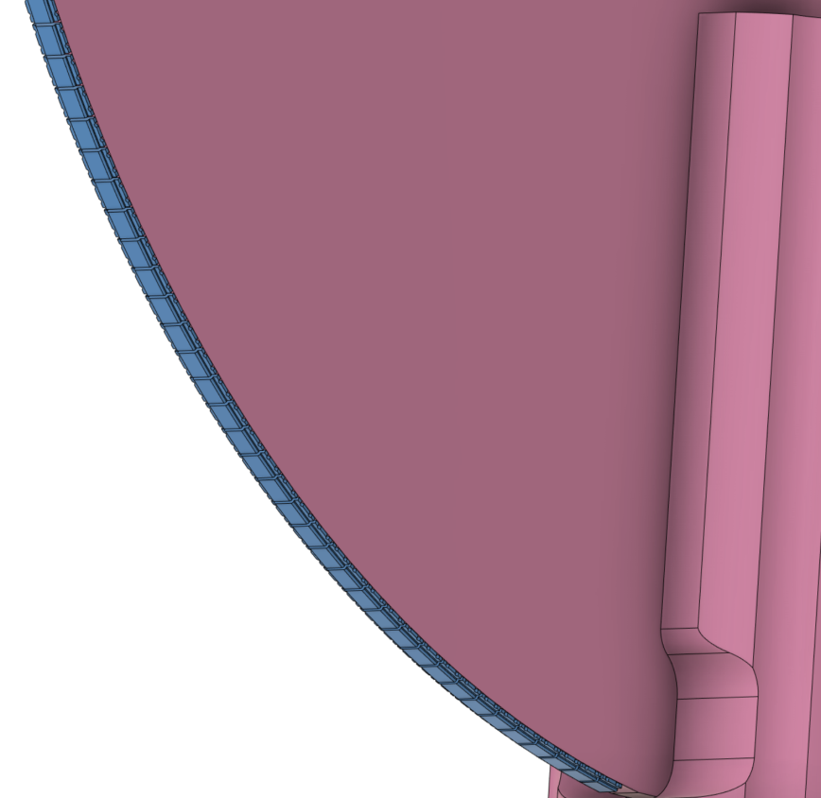
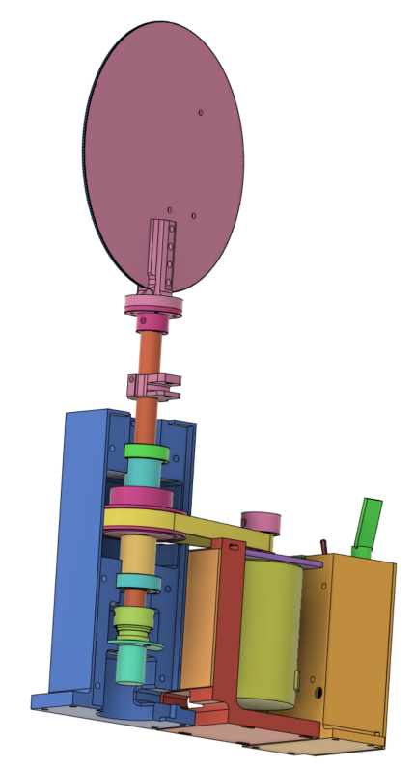
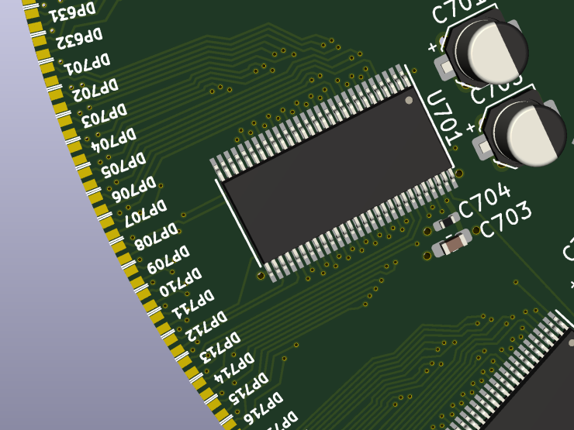
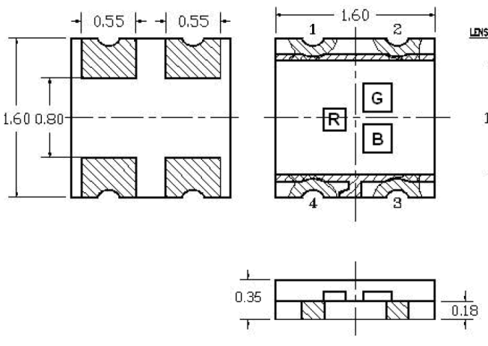
LED
LTST-C19HE1WT

Slide 18
Desired
Reality

Slide 19
Raspberry PI
Rotation timing
Photo- interrupter
DVI decoder
DVI interface
FIFO
LED driver initialization
Shift
registers
LED Driver
LED Controller
LED Driver
LED Driver
10 MHz
Clock/ Reset
RAM controller
FIFO
RAM init logic
RAM interface
Refresh logic
SDRAM

Slide 20


128pixels
Angular rotation
0°
1024 pixels
Original Image
359.65°
Scaled and rotated image
as displayed by Pi

Slide 21
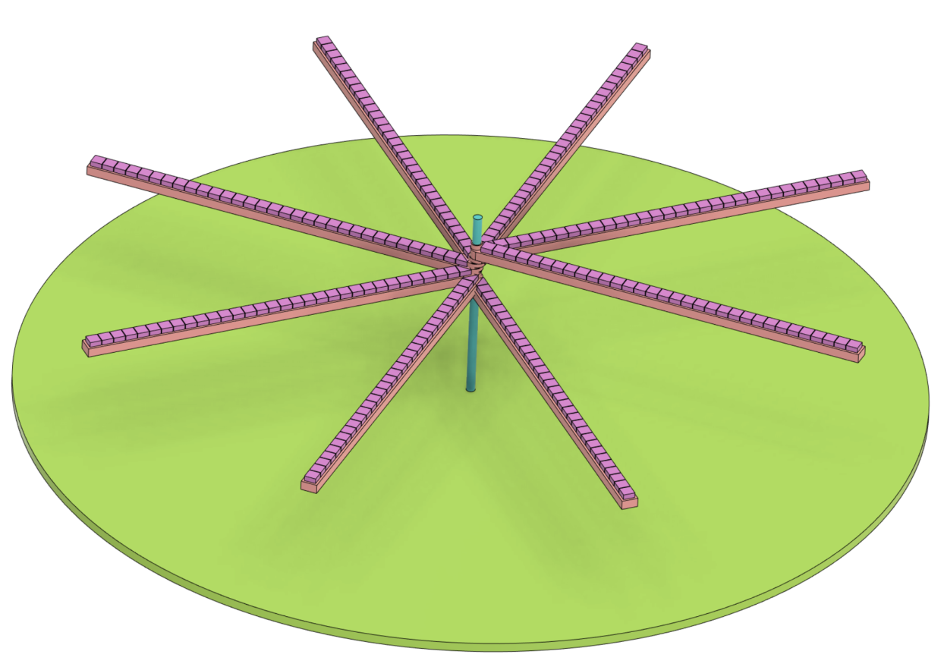
LED PCB x8
32 LEDs 2mm ▢
~13cm
Controller PCB
15cm Ø
~20mm

